Slide 1
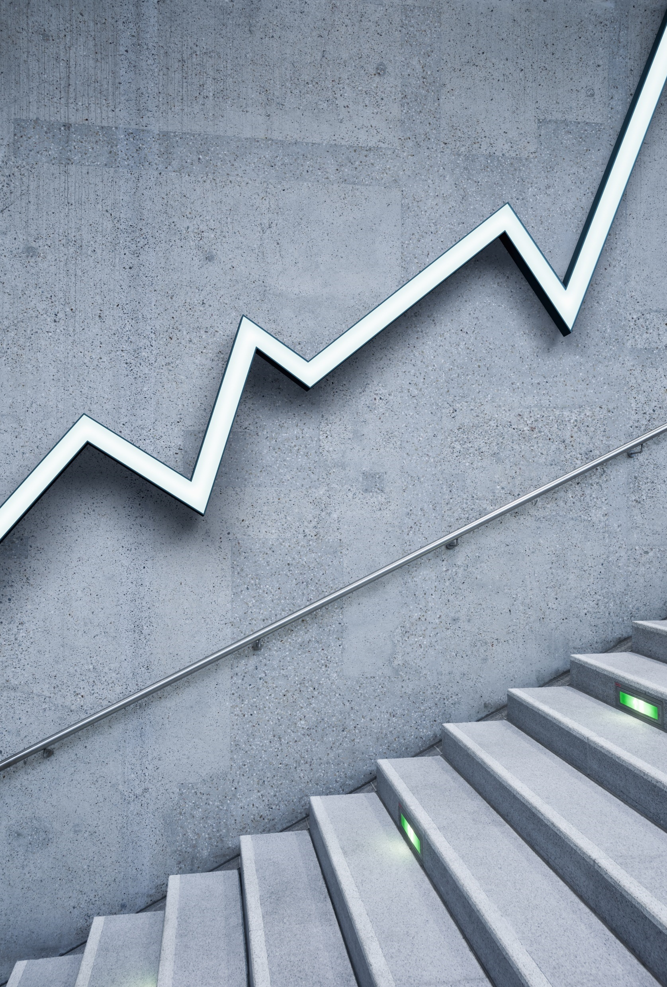
Empowering the nation
Cuba, Njabulo and Noma

Slide 2
Reflection
My name is Nomathamsanqa Moyo and this was a tough season we had our difficulties I mean every group does

Slide 3
Our strengths
Group members bring unique ideas, experiences, and viewpoints. This diversity can lead to more innovative solutions and creative approaches that might not be possible in individual work.
We were able to help and support each other, whether through emotional encouragement, technical advice, or offering feedback. This fosters a sense of community and makes it easier to overcome challenges.
Being part of this group can helped maintain accountability. We the members often feel a sense of responsibility to contribute effectively.
With clear roles and collaboration, we were able to achieve more than individuals working separately.

Slide 4
Our weaknesses
Poor communication lead to misunderstandings, confusion, or incomplete work. Because group members were not clear about their roles or objectives, productivity can suffer.
Differences in personality, work style, or opinion lead to conflicts within the group, we were not managed properly, this then lead tension and affect group dynamics, slowing down progress.
Some members contributed less than others, relying on their teammates to carry the workload. This then lead to resentment among more active members and reduce overall team effectiveness.
Reaching a consensus was difficult, because group members had opposing views. This then lead to delayed decisions, compromise solutions that satisfy no one, or even gridlock where no progress is made.

Slide 5
My personal reasons
I feared that my contributions would be judged negatively by other group members, leading them to hold back ideas, questions, or feedback. This then resulted in under-participation or feeling isolated.
my inability to manage time effectively lead to missing deadlines or not completing tasks on time, which then caused frustration within the group. Procrastination also lead to rushed work that may not meet group expectations.

Slide 6
solutions
Respect everyone’s contributions, regardless of their position or experience level. Avoid interrupting or dismissing others' ideas and encourage a supportive attitude toward each other.
Mutual respect strengthens group cohesion and promotes positive collaboration, even when there are disagreements.
Schedule regular meetings or check-ins to monitor progress, address any concerns, and keep everyone on track. Setting specific deadlines helps maintain momentum and ensures accountability.
Regular communication and deadlines prevent delays and help the group stay aligned with project milestones.

